Slide 1

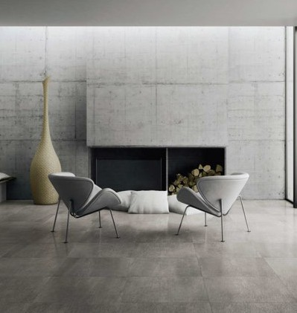
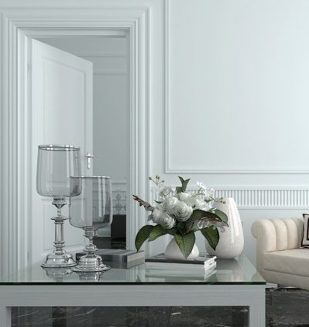
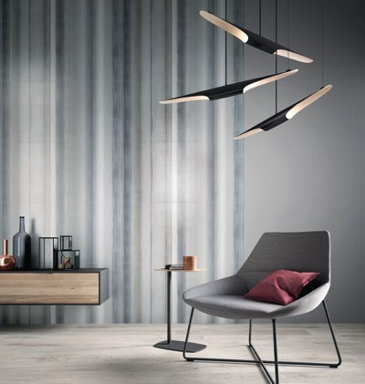
By Tech Hub Decor
Tech Hub Decor
STYLISH • EFFICIENT • AFFORDABLE

Slide 2
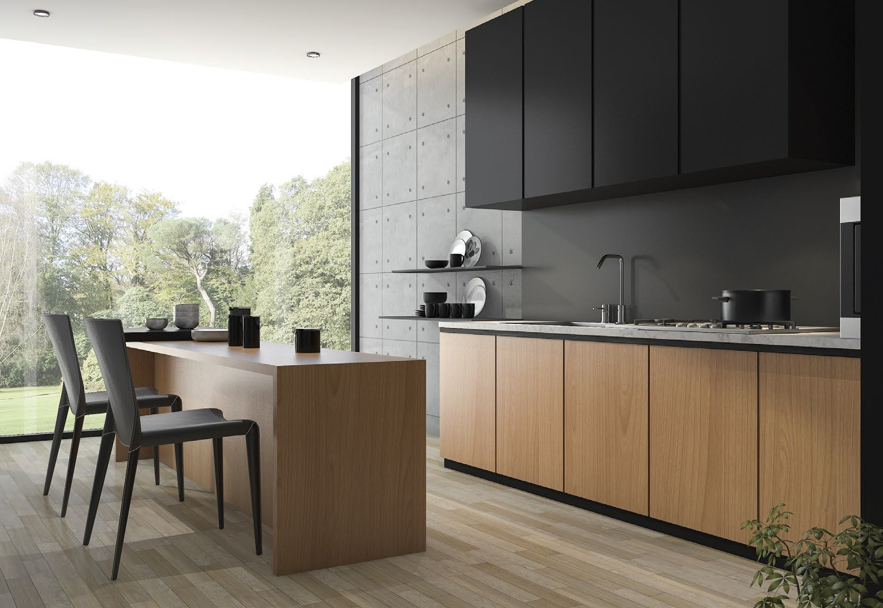


A Word About Us
We care for your home.
We are aware of the emotions associated with your dream home. We also understand that you are looking for home decor that is stylish, yet aﬀordable. Our professionals listen to your preferences, top it up with their expertise and try and replicate your personality in your home decor. We take care not to compromise on quality and ensure to deliver a product you would want to boast of. For us, every home is an emotion in itself.
Tech Hub Decor

Slide 3
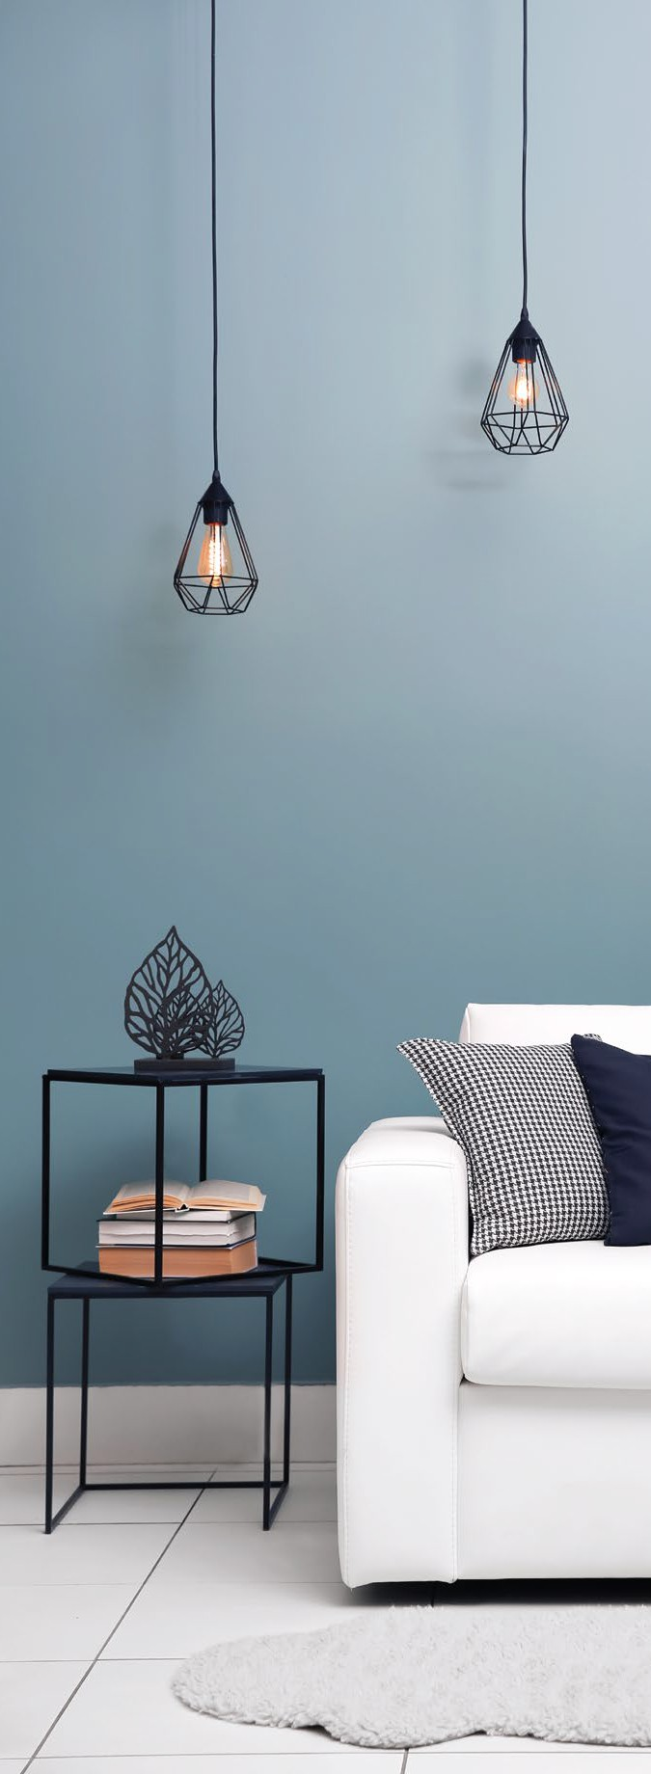





All About Interiors Under One Roof
By Tech Hub Decor
Modular Solutions Modular Kitchen Wardrobes
TV Unit Storage Unit
On-Site Services
False Ceiling Design
Electric and Plumbing Services Demolition and Repairs
On-Site Carpentry
Wall Design/Paneling & Painting
Terrace Garden Flooring Work
Furniture and Décor Soft Furnishing Customized furniture for every room
Decorative Pieces Decorative lighting Metal/Wooden Wall Art
And Lot More Personal Designer Design & Concepts Art Panels
Easy Payment Options

Slide 4
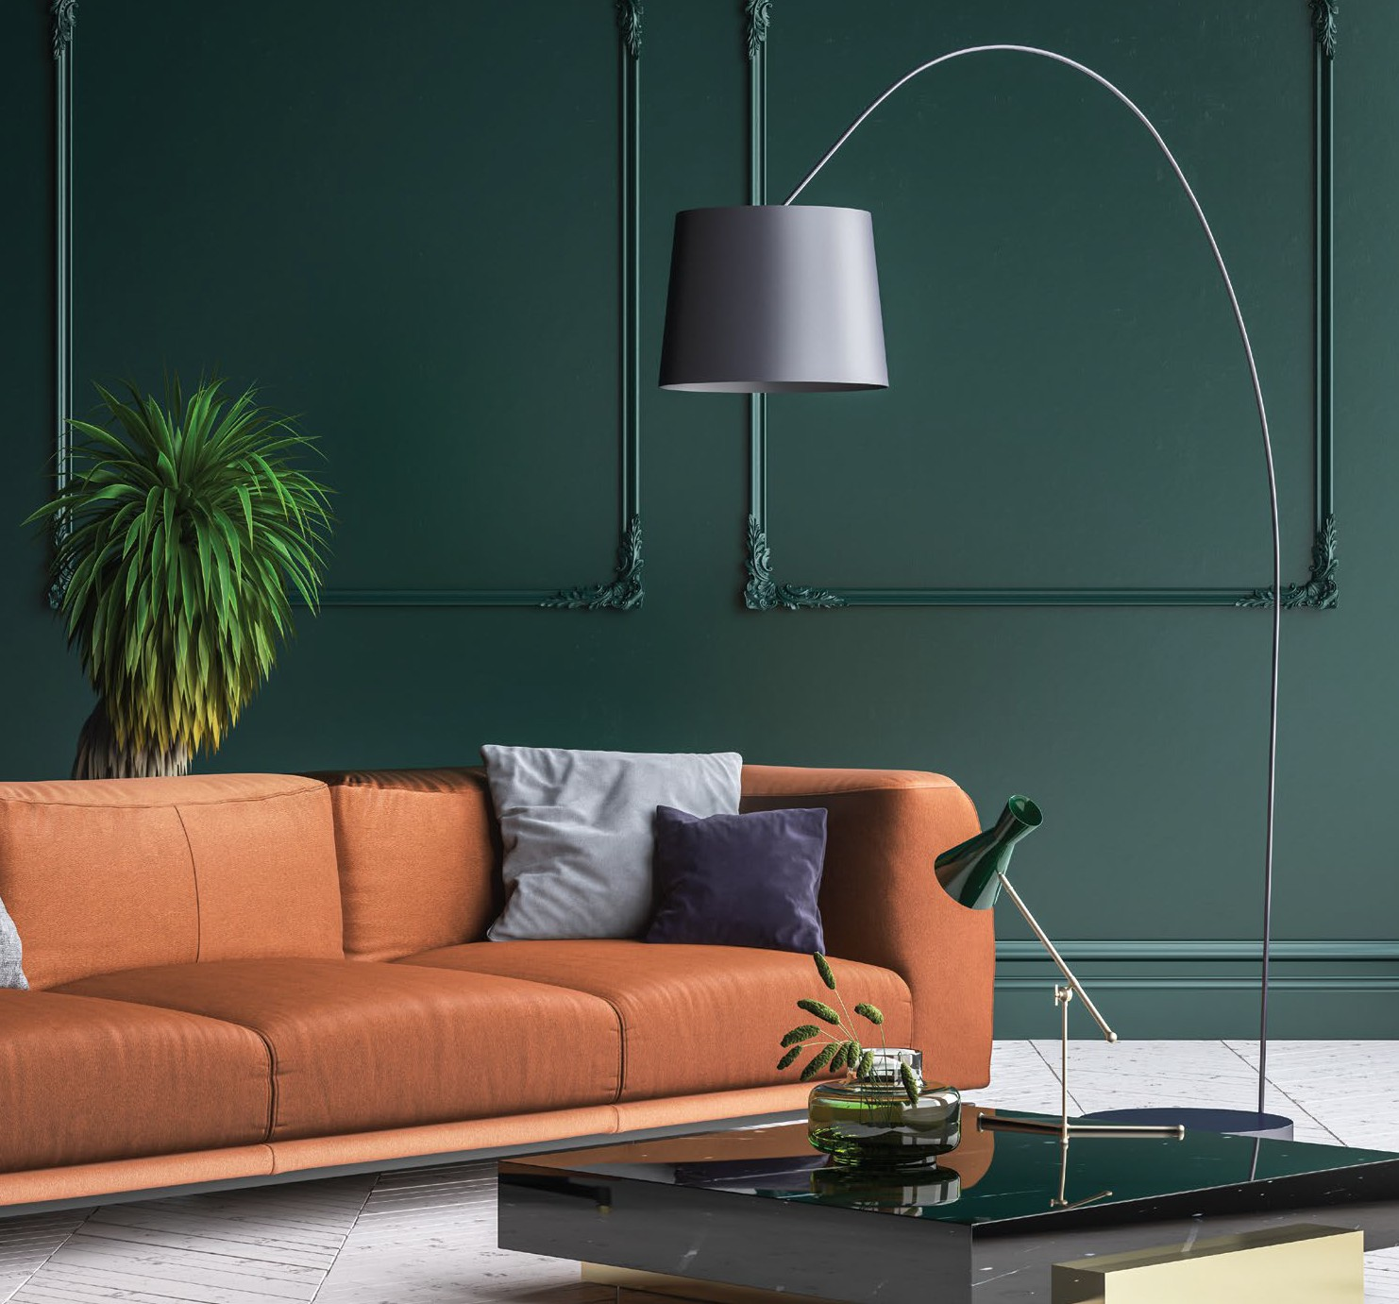
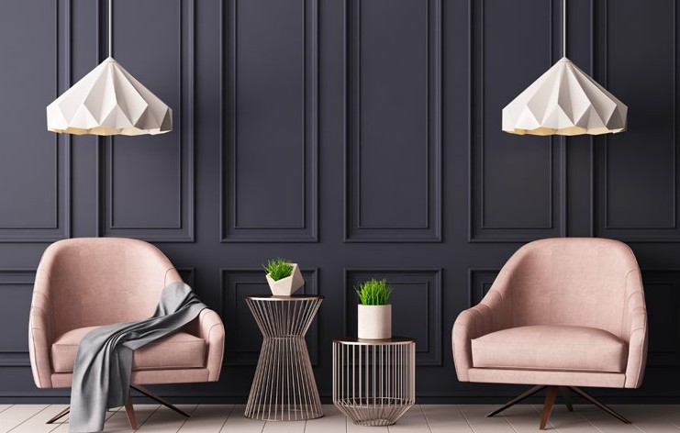
LIVING
ROOM DÉCOR
Wish to make a statement about your home décor? Then living room is the place you should start with. Minimalist, contemporary, vintage, or rustic – we understand that it is not easy to make your choice. That is where we step in to simplify the journey for you.

Slide 5
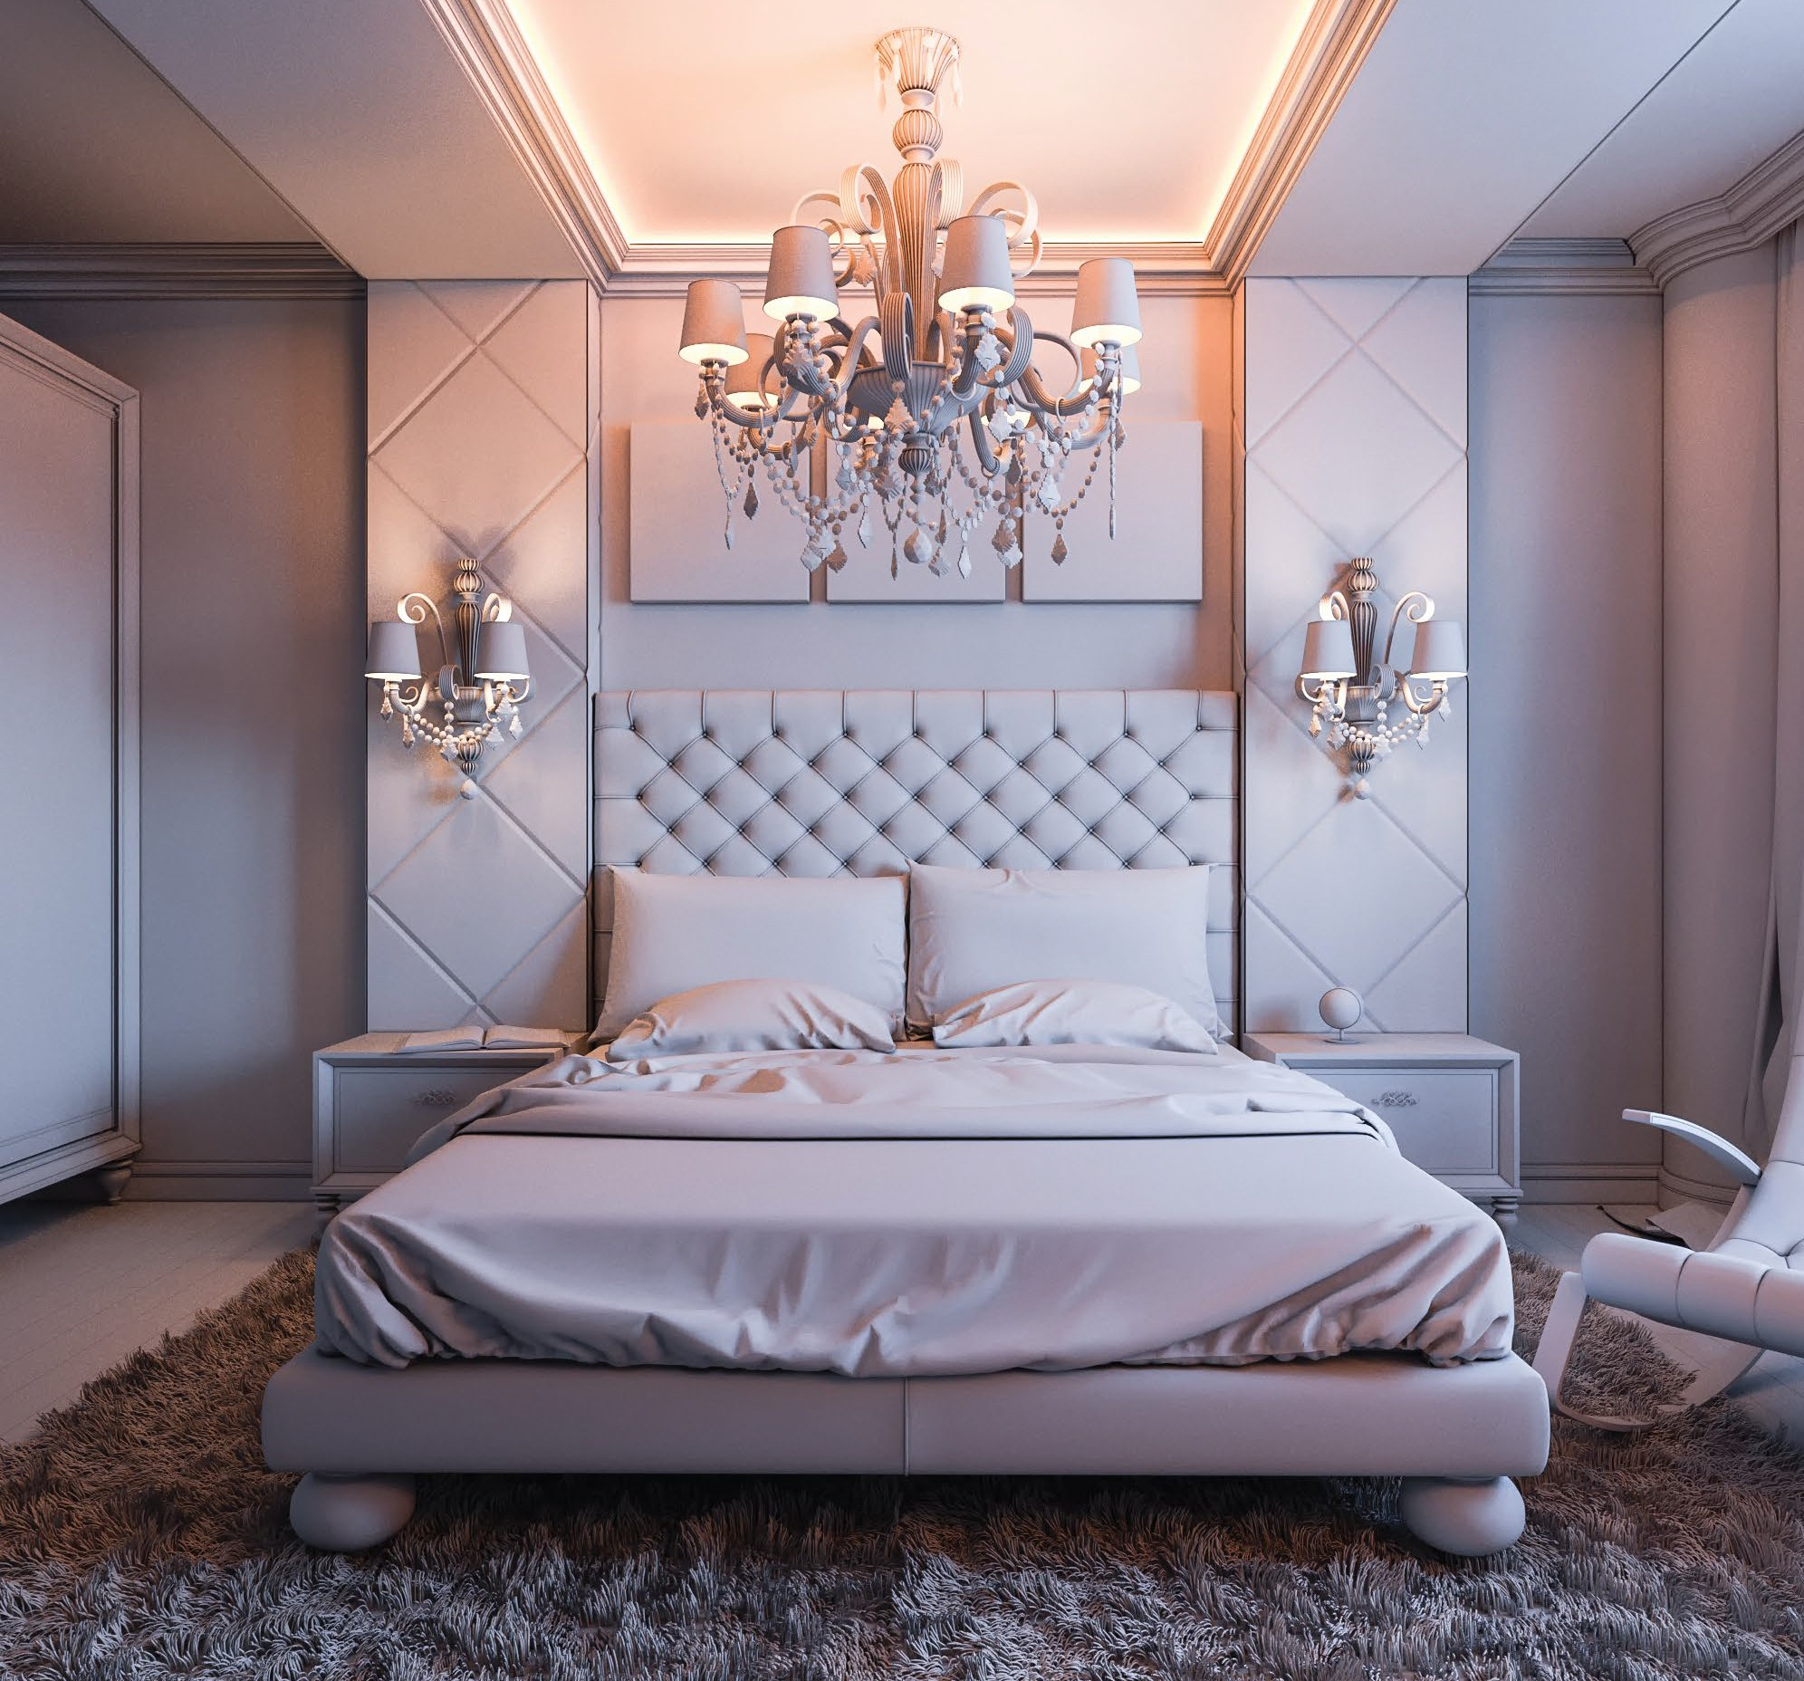
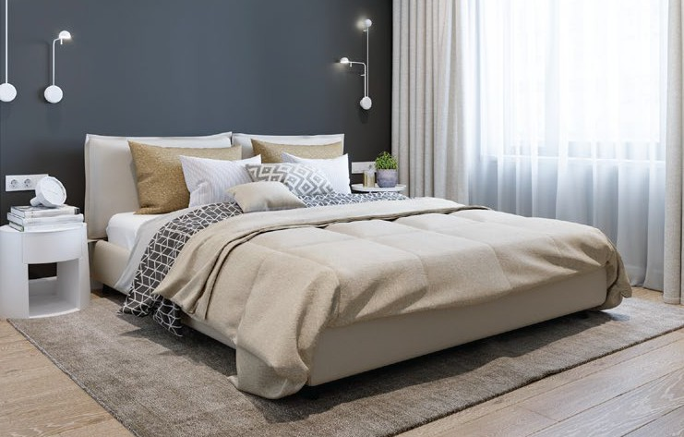
BEDROOM DÉCOR
Never ignore the signiﬁcance of choosing the perfect bed for your bedroom. As it is where you relax after a busy workday. Whether you love bold patterned headboards or have an understated style, we ensure to create a space that melts your stress away.

Slide 6
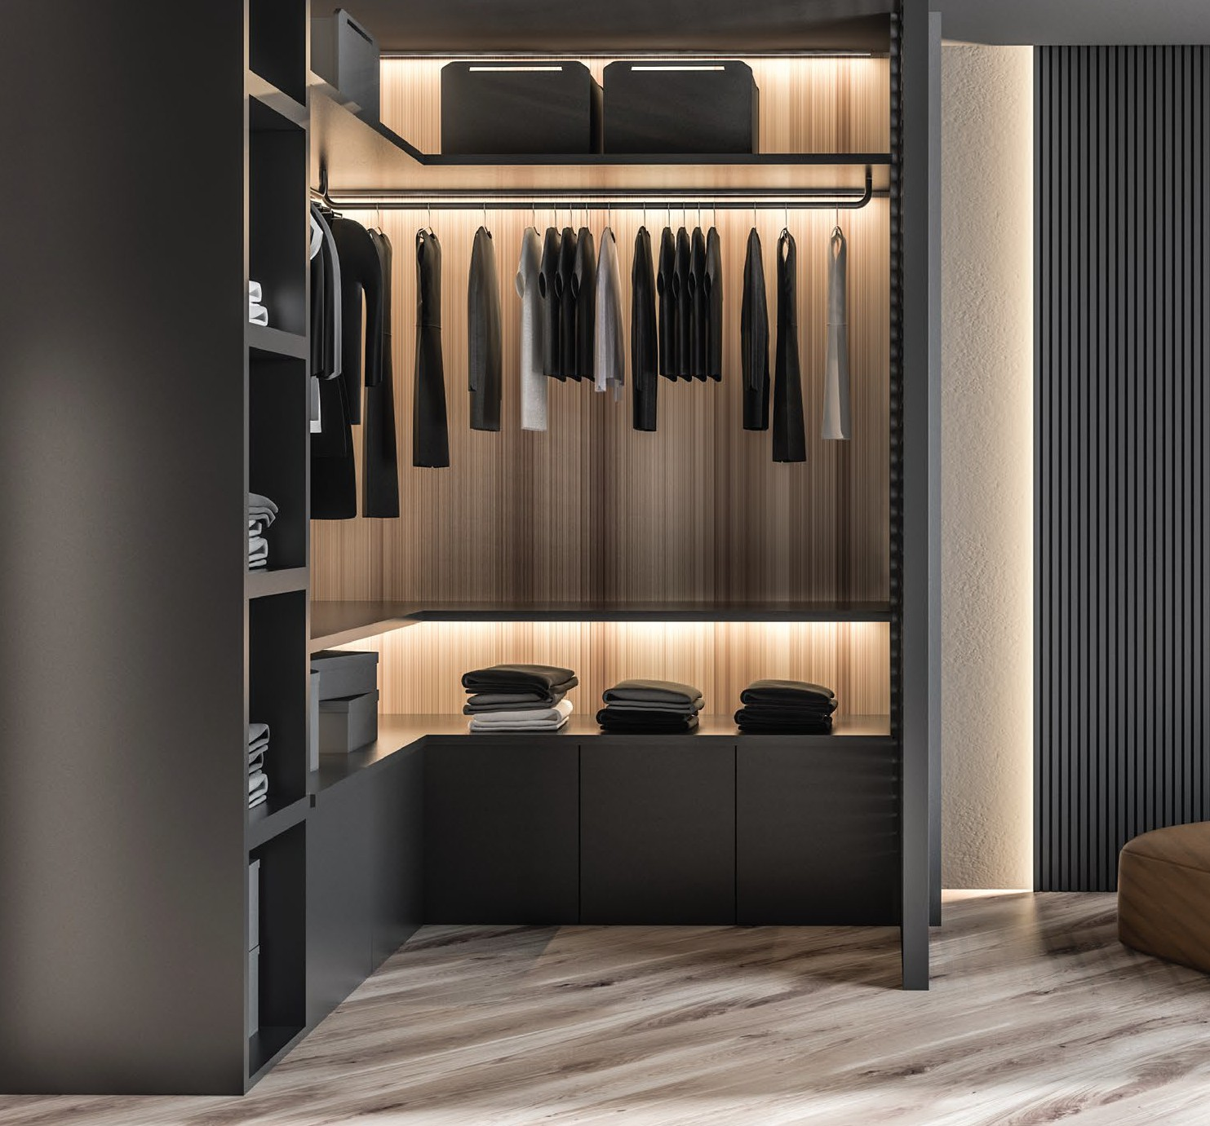
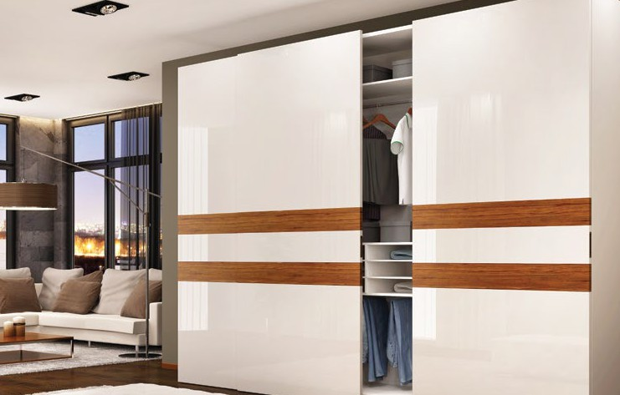
WARDROBE DESIGNS
Our handpicked selection of wardrobes ﬁt like a glove in your room. We oﬀer a myriad of wardrobes, closet options made from durable materials that come with an added guarantee. Wardrobe with mirror doors, built-in cupboard,
see-through cupboard, sleek or vintage wardrobe – you name it, we have it.

Slide 7
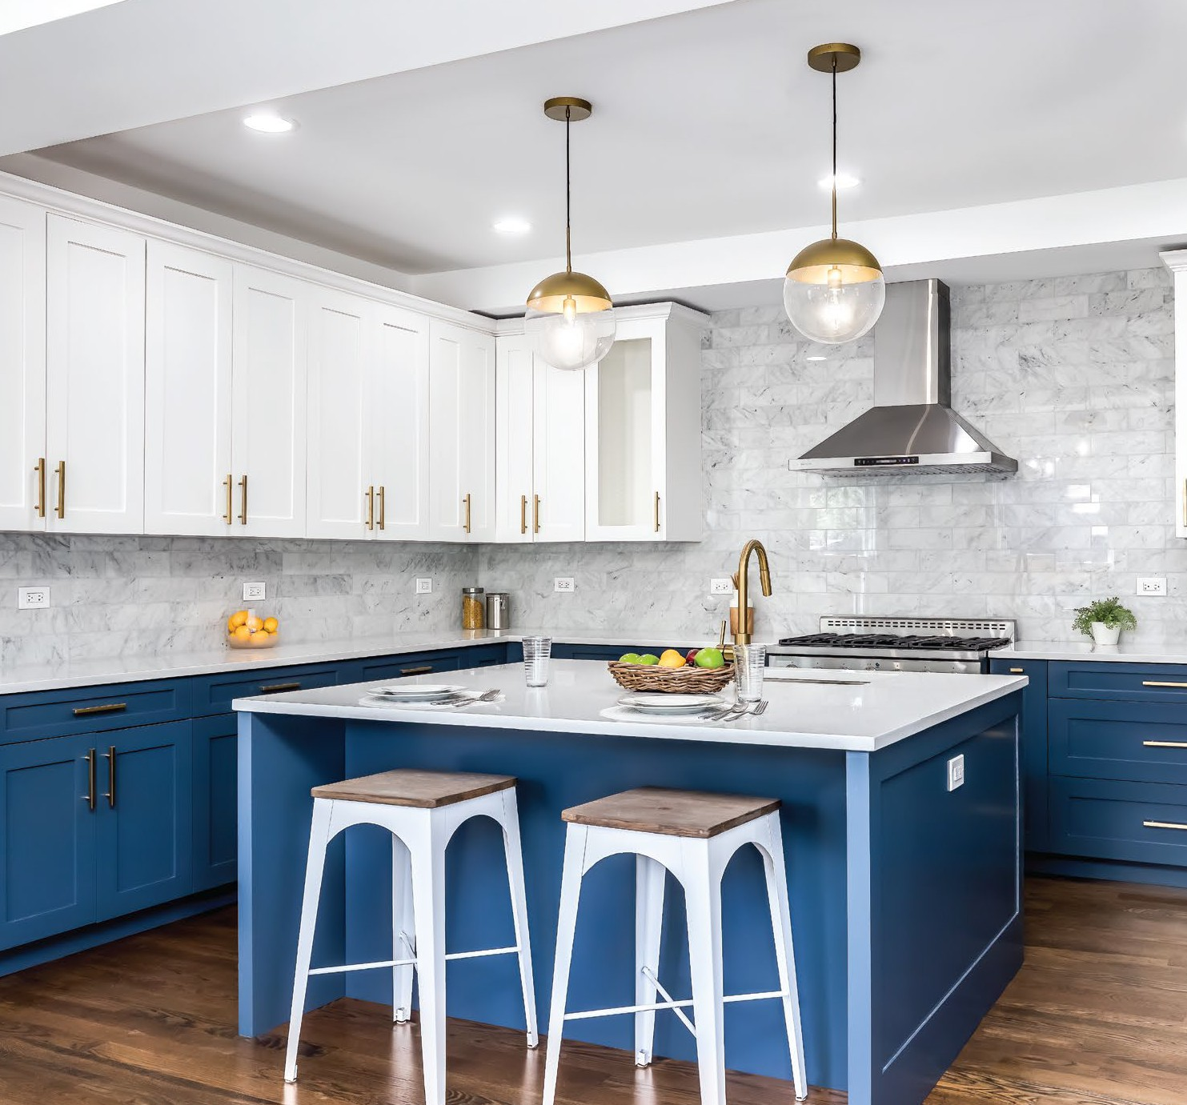
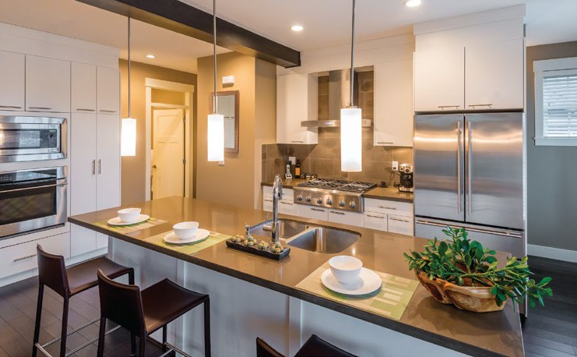
KITCHEN DÉCOR
Professional chefs, novice cooks and the ones struggling to prepare the perfect sunny side up. Our kitchen décor designs complement everyone. Leave all the worries about picking the kitchen island top, lacquer or simple cabinets, designer hardware, pendant lights, tiles, ﬂoors, dining table – to us.

Slide 8
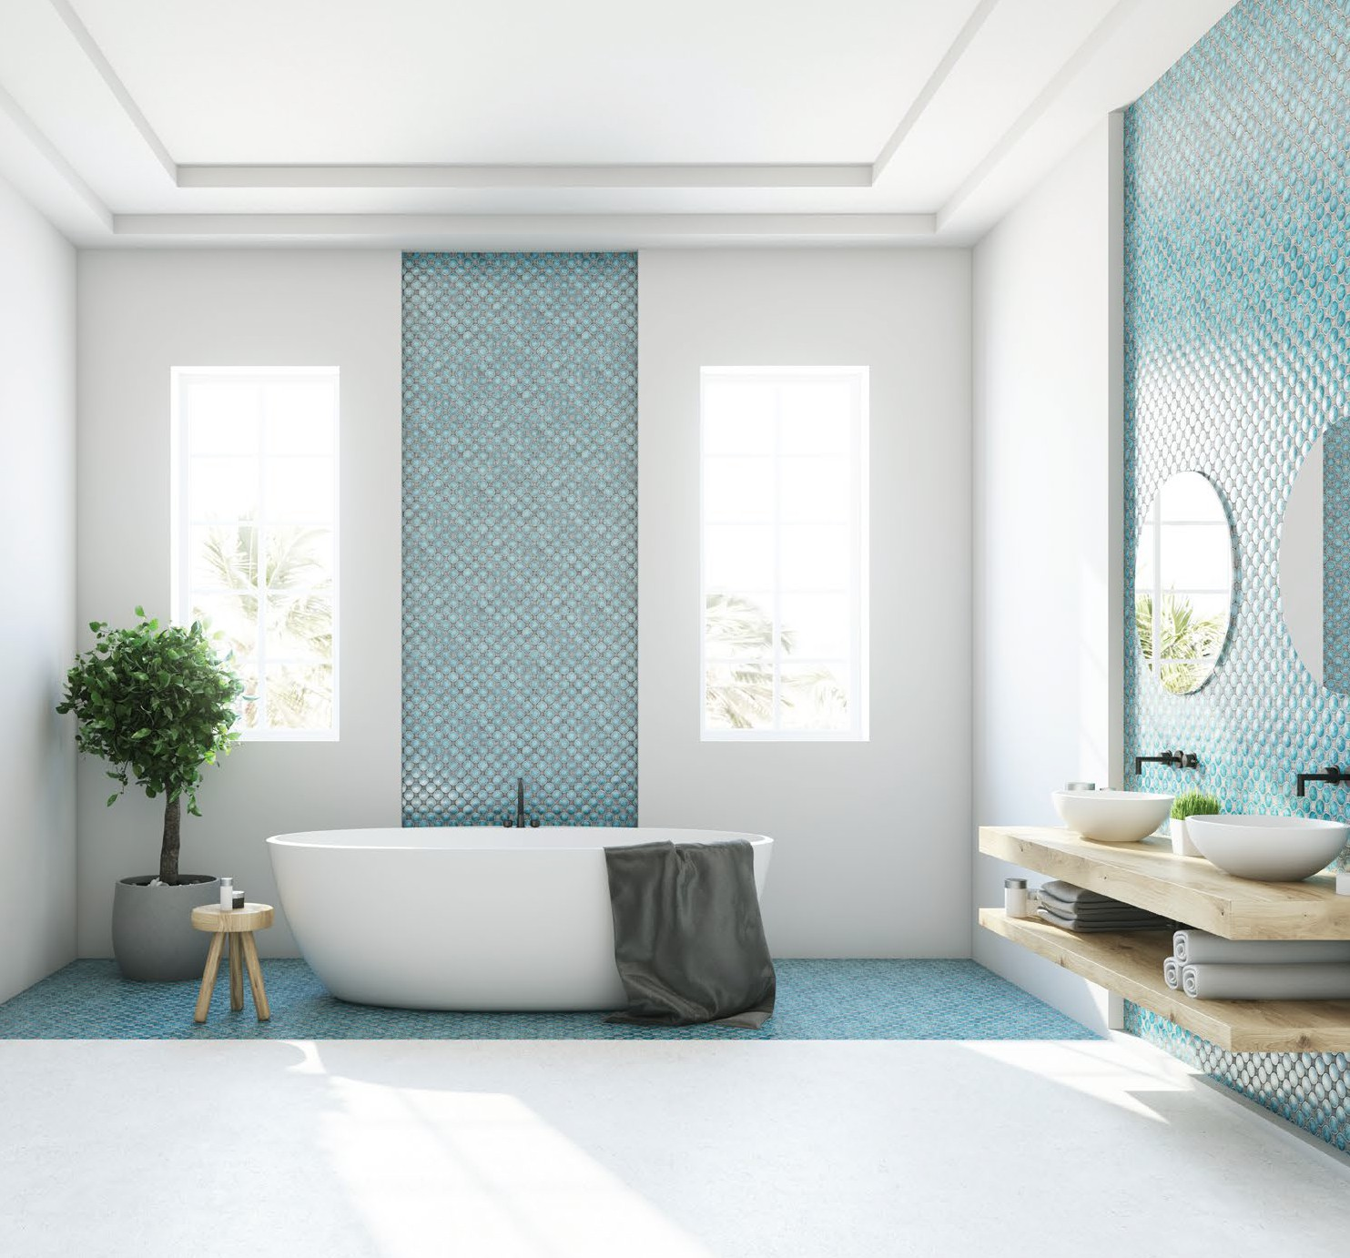
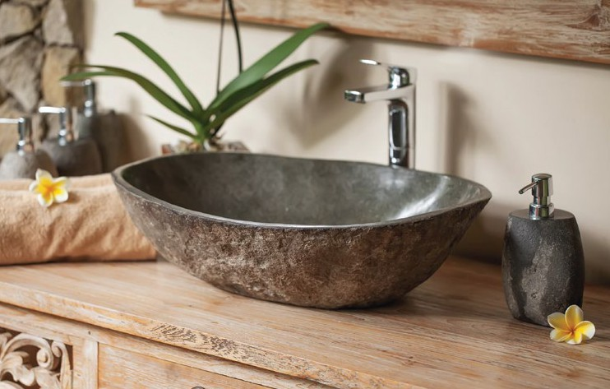
BATHROOM DÉCOR
While you invest in bedroom, living room, and hallway décor, your bathroom décor is often overlooked. So, whether you like a bathroom with a walk-in shower, a luxury sanctuary with expensive décor or a strictly practical one, we make sure you will never miss those luxury hotel experiences.

Slide 9
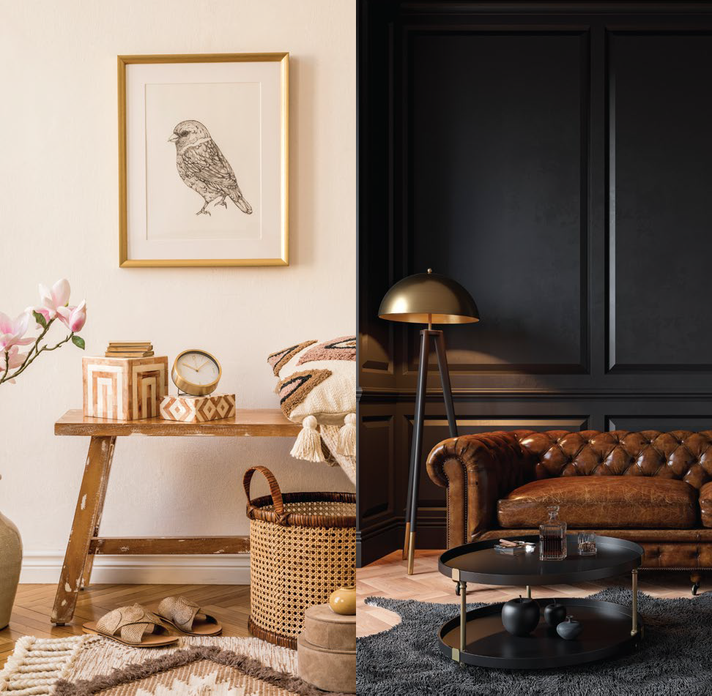
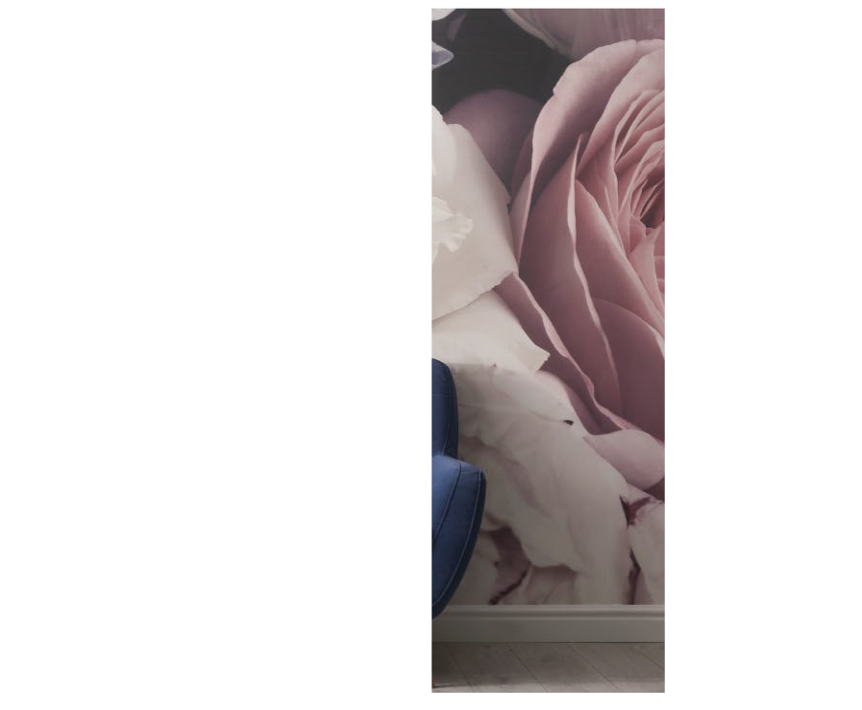

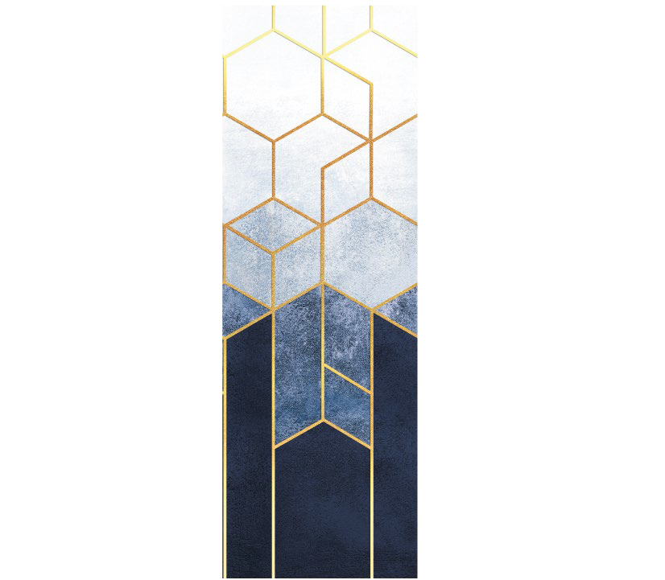
HOME
STYLING
A simple cramped space can look like a million dollars with the right home styling element.
We create awe-inspiring interiors while taking care of the small details like the perfect blend of form, pattern, texture, and light to create that stylish home you have always dreamed of.
WALL
TREATMENT DESIGNS
Wall Treatment Designs lend you the freedom to upgrade your past preference and add panache to your home décor with another one that goes well with your new furniture. Choose between modern, classic, simple prints or a mix and match of diﬀerent patterns. We have several peel and stick options also for people who lose their interests easily.

Slide 10
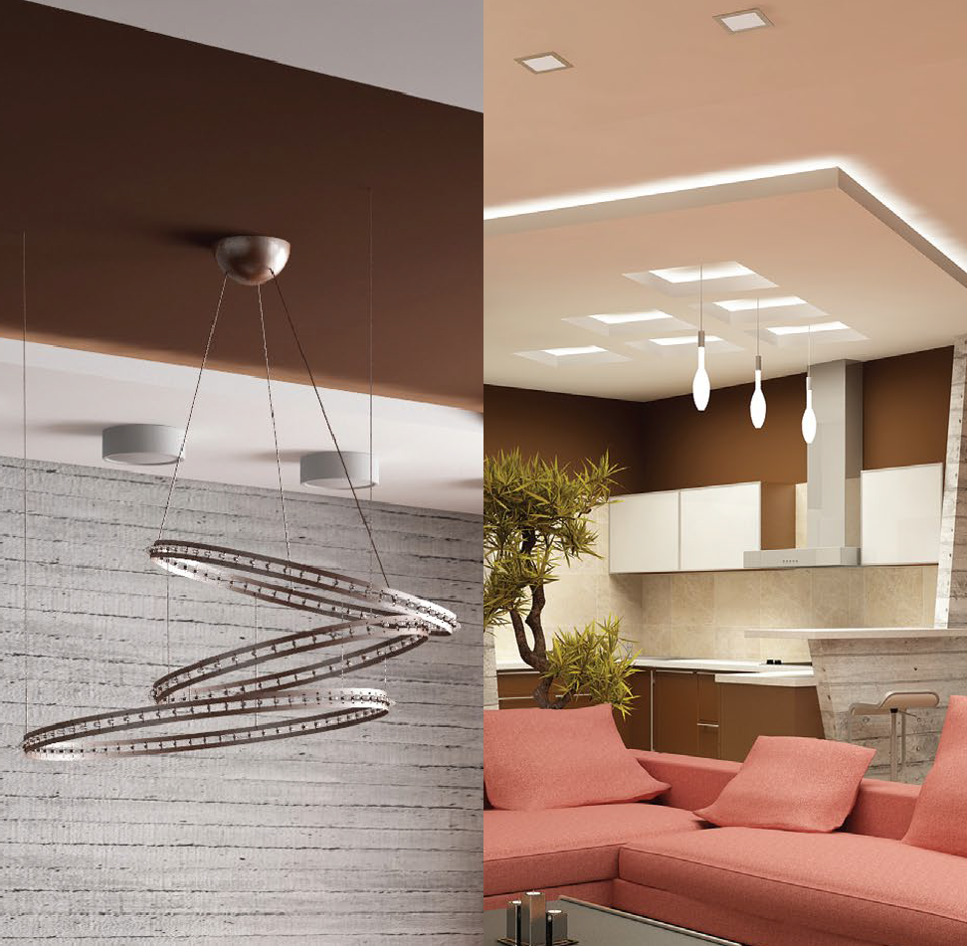

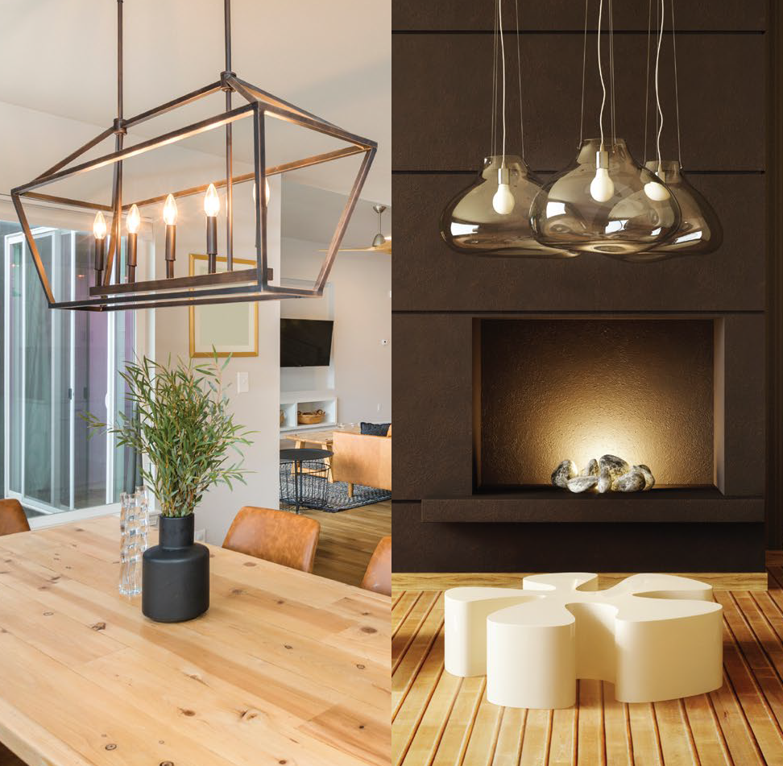
FALSE
CEILING
Your ceiling could be one of the most overlooked areas of your room. But it is always a good idea to dress it up a little. It is your aesthetic call that how you want to beautify your ceiling – with plaster of Paris, wood, gypsum, metal, glass, or fabric.
DECORATIVE LIGHTING
Decorative lighting can help give your room a stylish look. We complement your false ceiling with a decorative lighting if you wish to add a warm diﬀused glow in the room, want to add focus on diﬀerent objects placed inside the room or simply plan to illuminate the entire space.

Slide 11





How does it work?
By Tech Hub Decor
1
2
Meet Us
It all begins here
Share your Expectations
We Get to Know Your Taste
While we get to know about you, we ensure to follow your preferences to create the complete designing experience just the way you want.
Let us know more about each other.
We can meet over a cup of coﬀee or even online too. We'd like to know what you're looking for.
3
4
Make a Mood Board
Personalised Designs
Scope of Work
Finalising the Details
Now when you have made up your mind, it is the time to ﬁnalise the scope of work and talk about the essentials – materials and ﬁnishes etc.
Before ﬁnalizing your dream designs, we
prepare a mood board to help you visualize your new home and then discuss further enhancements.
5
6
Seal the Deal
Stress-free process
Execution
Speedy quality checks
While we immediately begin work on your diﬀerent orders, our quality control team keeps a strict check. We also keep you updated about the execution process.
Once ﬁnalised, you can seal the deal by
paying a signing amount of 10%. Pay 50% of the order value to kickstart the process and the balance before handover.
7
Move-in
It's all yours now
Your happily ever after begins here. . .
Congratulations! We are done. You can
now move-into your dream home.

Slide 12
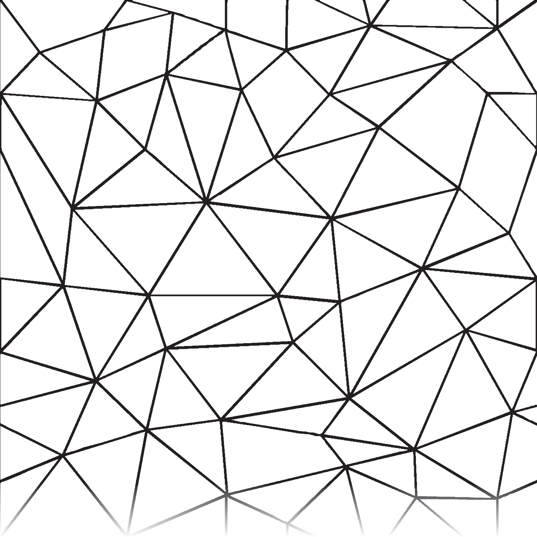


By Tech Hub Decor

